Slide 1
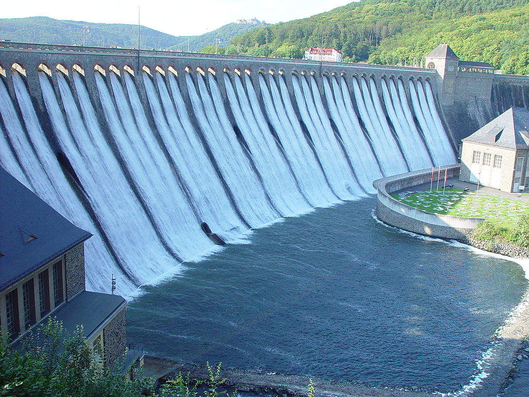
LEGAL DUE DILIGENCE
Power Project Acquisition through IBC 2016
Presented by-
Trans India Law Associates
Advocates & Legal Consultants
www.tila.in ©

Slide 3
Types of Mergers & Acquisitions
Classification of M & A
On the basis of Value Chain
On the basis of Relationship
On the basis of Economic Area
Horizontal
Vertical
Conglomerate
Friendly
Hostile
Domestic
Cross-border

Slide 4
Benefits of M & A
Economies of Scale- a classic example would be AB InBev acquisition of SAB Miller which will form a company that makes almost a third of the world’s beer supply.
Greater Efficiencies & Operational Synergies- Vedanta’s mega- merger with Cairn India and Aditya Birla Group merger of its branded apparels business Pantaloons Fashion and Madura Garments.
Access to new geographies & new products- ATC’s acquisition of 51% in Viom Networks to get access to the Indian Market. Merger of Charter Communication and Time Warner Cable which shall increase Charter’s footprint by 84,000 sq. miles.
Bringing in New Technology & Enhancing Capability of further Investment in Technology- Twitter’s acquisition of Periscope an app for streaming vedio from a cell phone, Infosys acquiring Panaya which is an ERP startup of Israel, Samsung electronics acquiring LoopPay’s technology turns magnetic-stripe readers into a new type of tap-like payment system, requiring no contact with a card.
Turnaround / Revival Strategy- Majority of distressed deals in US Oil & Gas happened due to low oil prices in 2015.
Diversification- Foray of traditional retailer’s in India into the online space like Mahindra Retail’s acquisition of babyoye.com, Aditya Birla going into e-retail through abof.com.

Slide 5
Insolvency & Bankruptcy Code, 2016
National Company Law Appellant Tribunal (NCLAT) Sec 61 (30+ 15) days
Committee of Creditors (CoC) Sec 30 (180+90) days
National Company Law Tribunal (NCLT) Sec 60
Supreme Court Sec 62 (45+ 15)days
Last date f or CIRP is 02.01.2020
Admission of CIRP for JPCL is on 09.04.2019

Slide 6
Procedure of Clearance
FLOW CHART OF CLEARANCES
CONCEIVE A PROJECT / MOU
Feasibility Report
Pre Investment Activities Approval
ENVIRONMENTAL
CLEARANCE
PRIOR ENVIRONMENT CLEARANCE (TOR) for EIA /EMP
FRA 2006
Forest Clearance (St- I)
SURVEY & INVESTIGATION, DPR, EIA & EMP REPORTS & INFRASTRUCTURAL ACTIVITY I/C LAND ACQUISITION (NON FOREST)
CONCURRENCE FROM CEA
NBWL Clearance
DEFENCE
CLEARANCE, IF REQD.
EFC/PIB
INTER-STATE &
INTERNATIONAL
ANGLE
AWARD OF WORK
APPROVAL BY FM/
CCEA
FOREST
CLEARANCE (St-II)
CONSTRUCTION WORK
FOREST
CLEARANCE (St-II)

Slide 7
Areas of DDR
Chapter 1: Corporate Documents- Details of promoter, memorandum and articles of association, shareholding pattern of the Company, registers of Company, annual reports, directors report, internal audit and independent audit reports.
Carried out ROC and MCA search
Chapter 2: Business Contracts- Customer contracts, supplier contracts, other existing contracts(if any),sector specific contracts such as Bulk Power Transmission Agreement.
Chapter 3: Consents and Approvals- Licenses, permits, authorizations and consents Restrictions/conditions
Chapter 4: Indebtedness and Liabilities- Loan agreements, credit, finance, pledges, mortgages etc. Repayment status, details of default
Chapter 5: Labour and employment- Details of total number, types and grades of employees, wages and salary scales, employment contracts, benefit plans relating to employees, compliances with regard to various labor legislations in India
Chapter 6: Dispute and Litigation- Pending or threatened claims, litigation, arbitration and administrative actions, details of criminal proceeding against Company, director etc, Details of Judgments/orders passed against the Company.

Slide 8
Chapter 7: Land & Assets- List of Locations and offices of the Company, details of land and other immovable properties owned or occupied by the Company, title documents, assets, equipments etc.
Chapter 8: Insurance- Insurance Policies in force, claims raised in the past 3 years.
Chapter 9: Intellectual Property Rights- Details of trademark, patents, copyrights, designs etc
Chapter 10: Information Technology- Details of specialized software or hardware(if any) owned or used by the Company and which are essential for the Conduct of its business.
Chapter 11B: Power Project Clearances from statutory authority- Clearances from statutory authority, Clearances from Central Government, CEA, State Government.
Chapter 12: Opinions and Conclusions

Slide 9
S. 31 Approval of Resolution Plan
The Corporate Debtor under IBC is discharged on the approval & implementation of the Resolution Plan.
by the Adjudicating Authority
As per section 31 of IBC the Corporate Debtor is discharged by Operation of Law

Slide 10
Rights of Equity Shareholders
Matter examined by the Ministry of Corporate affairs in light of provisions of Sections 30 & 31
Vide Circular dated 25.10.2017, No requirement of obtaining approval of Shareholders / Members of the Corporate Debtor during the process
IBC Circumscribes the rights of Equity Holders. Shareholders do not get to vote on any resolution plan

Slide 11
Can Creditors pursue pending Litigation/ Arbitration ?
Section 60(6) of Insolvency & Bankruptcy Code, 2016
“Notwithstanding anything contained in the Limitation Act,1963 or in any other law for the time being in force, in computing the period of limitation specified for any suit or application by or against a corporate debtor for which an order of moratorium has been made under this Part, the period during which such moratorium is in place shall be excluded.”
In Kotak Mahindra Prime Ltd. V. Mr. Bijay Murmuria & ors., NCLAT held that once a creditor, financial or operational files its claim before the resolution professional & a “Successful Resolution Plan” , which gives them the same treatment as the other similarly situated creditors, thereafter can’t take the benefit of Sec 60(6) of the Insolvency & Bankruptcy Code & pursue any litigation or arbitration with respect to the same claim

Slide 12
OPINION ON CCI
Governing Act- Competition Act, 2002
Insolvency and Bankruptcy Code, 2016 and IBC (Second Amendment) Act, 2018- Section 31(4)
The Resolution Applicant shall pursuant to the resolution plan obtain the necessary approval within a period of 1 year.
Provided that where the resolution plan contains a provision for combination under Section 5 of Competition Act, 2002 approval of CCI required prior to the approval of such resolution plan by COC

Slide 13
In SBI v. V. Ramakrishnan 2018 SC 963
The Hon’ble SC Placed strong reliance on S.31 of IBC which states once the resolution plan is approved it will be binding on all stake holders including the guarantors.
It held hat the guarantor cannot be relieved from making payment by virtue of section 133 of the Contract Act even if the debt is varied under the resolution plan.

Slide 14
Thank You if we work together Right to Energy is possible
Disclaimer- The data presented is based on the information available on the websites of the countries and is the best of our knowledge. However there may be error in the data produced and its purpose is to provide general information, and not to provide specific legal advice.

Slide 15
Let Work together! Talk to TILA @ +919810070075 Whatsapp your Questions @ +919810070075 Email @ rsn@tila.in Know us by visiting : www.tila.in / www.dgef.in

